Slide 1
Cybersecurity Capstone Netcat Project Presentation for 10ALYTICS-DC
JUDE CHIDUBEM ANYAEGBU

Slide 2
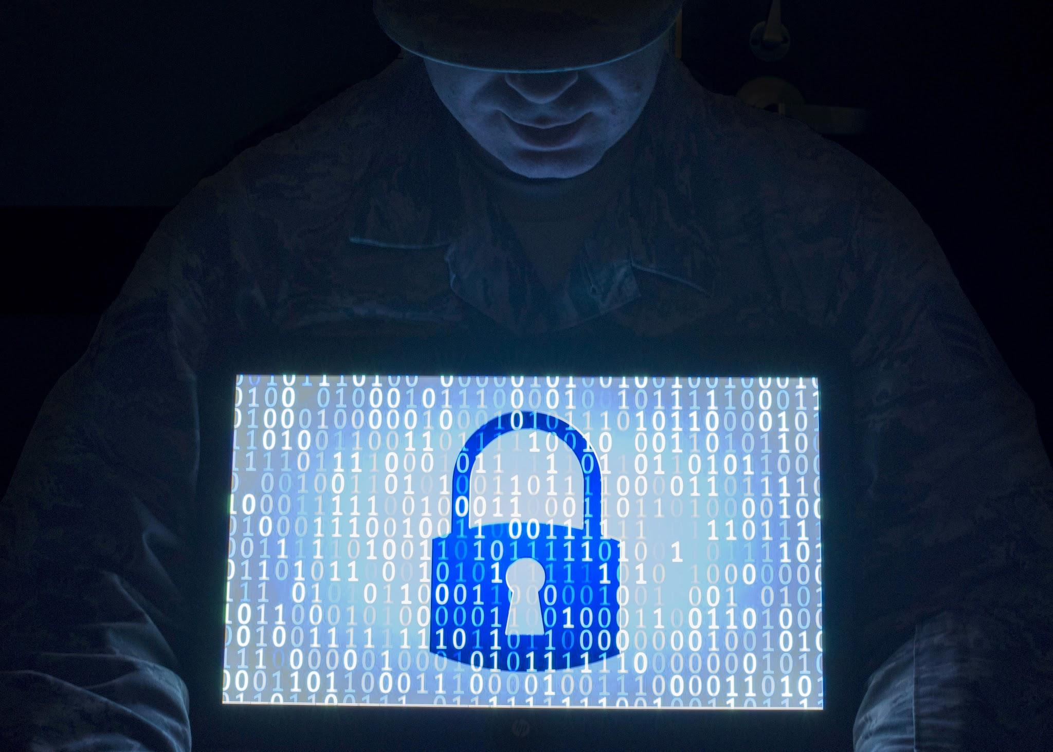
Title: Strengthening Security Monitoring at 10ALYTICS-DC
Subtitle: Detecting Unauthorized Netcat Processes with Wazuh
Details:
Presented by: Jude Chidubem Anyaegbu
Date: June 18, 2025
Capstone Netcat Project for 10ALYTICS-DC

Slide 3
PROJECT PROCEDURE

Slide 4
Project Overview
Content:
Problem: Threat intelligence reports increased attempts to exploit systems via unauthorized tools, particularly Netcat.
Goal: Enhance security monitoring using Wazuh to detect and block malicious processes in real-time.
This project addresses critical security gaps at 10ALYTICS-DC by leveraging Wazuh’s capabilities to monitor and respond to unauthorized Netcat usage, a common tool for data exfiltration and backdoors."

Slide 5
Materials
Laptop
Ubuntu VM
Kali VM
Wazuh VM
Slack App
Netcat VM
The project was carried out with virtual machine tools listed

Slide 6
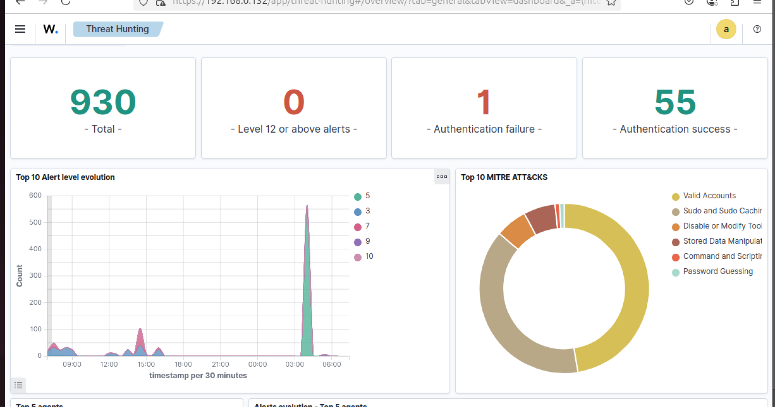
Objectives
Detect unauthorized Netcat processes, especially in listening mode.
Generate real-time security alerts for suspicious activity.
Implement active response to terminate malicious processes.
Document findings and provide mitigation strategies.

Slide 7



Methodology
Deploy Wazuh manager and agents on Linux servers.
Configure process monitoring for Netcat detection.
Create custom Wazuh rules for alerting.
Set up active response to terminate unauthorized processes.
Archive results and document findings.

Slide 8
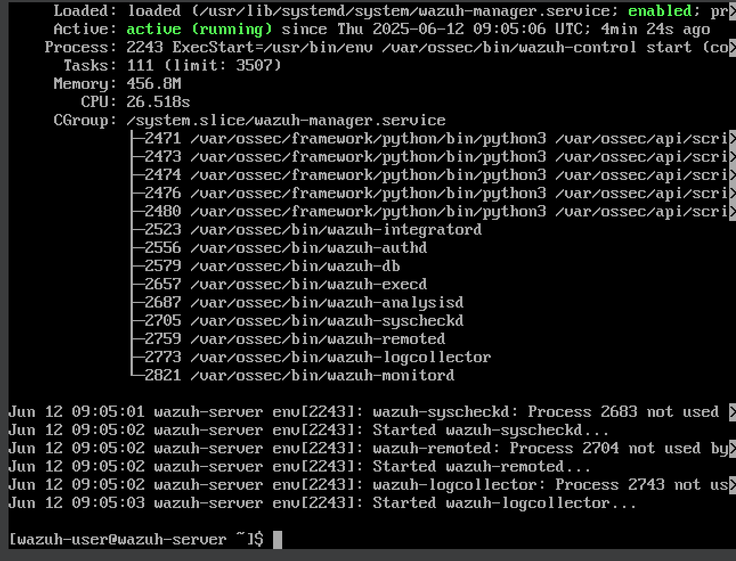
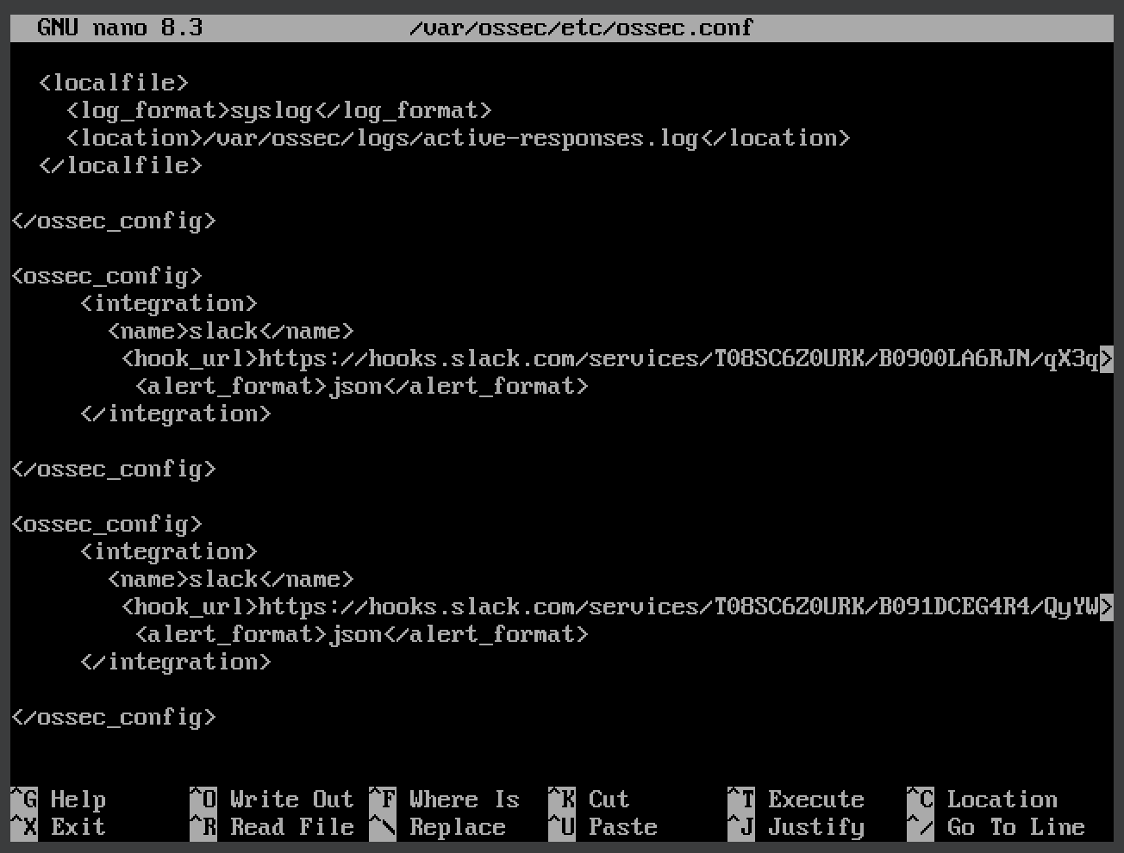
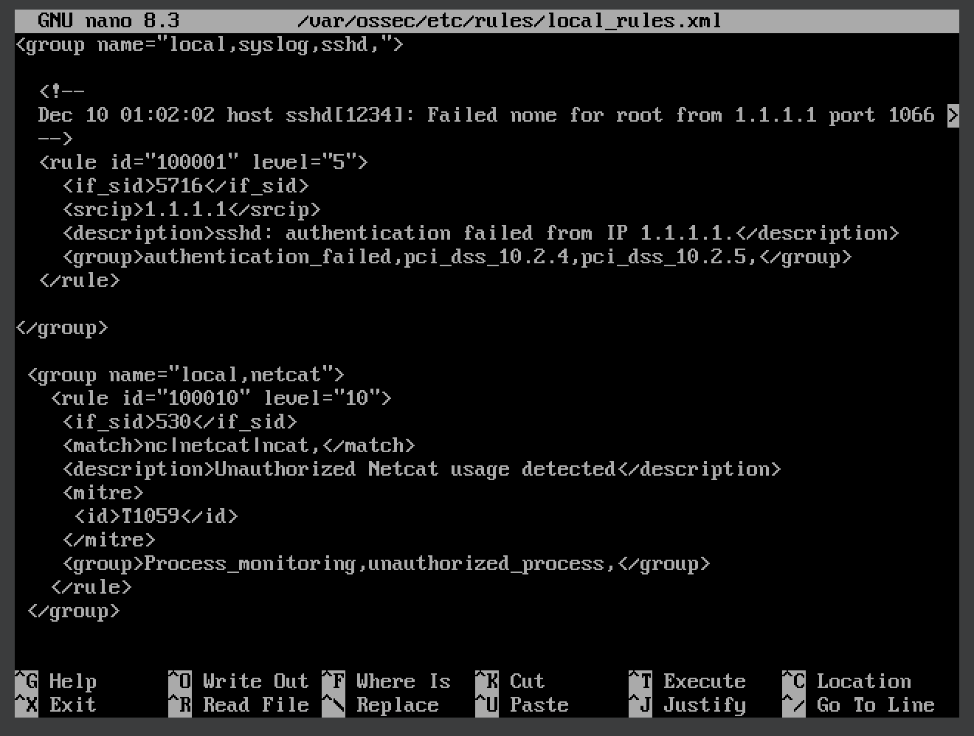
ACTIVE STEP
SET UP WAZUH :
Start wazuh manager, dashboard, and Indexer, with {sudo systmctl start wazuh- …}
Run wazuh-manager status {sudo systmctl status wazuh-manager}
Run {ifconfig} to confirm my ip address
Integrate my slack app on wazuh for real time monitoring by running {sudo nano /var/ossec/etc/ossec.conf} this action came after creating app in in slack platform
I create Netcatcat rule after set up my wazuh agent in ubuntu {sudo nano /var/ossec/etc/rules/local_rules.xml}

Slide 9
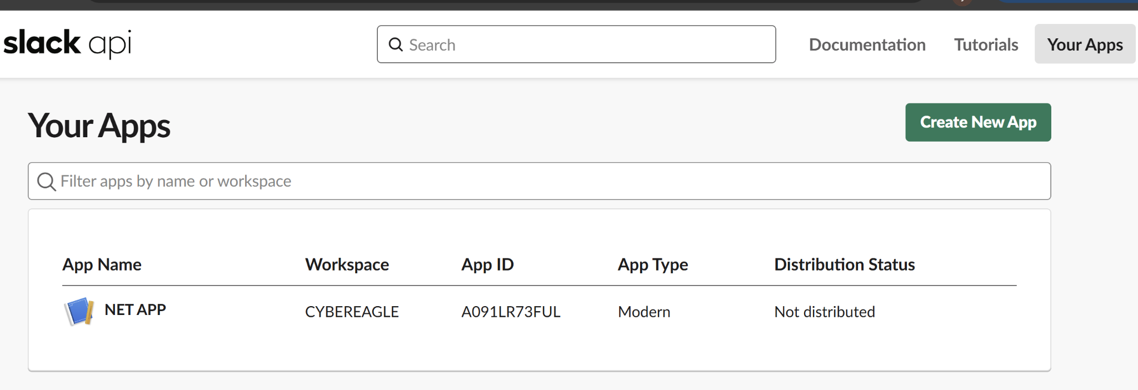
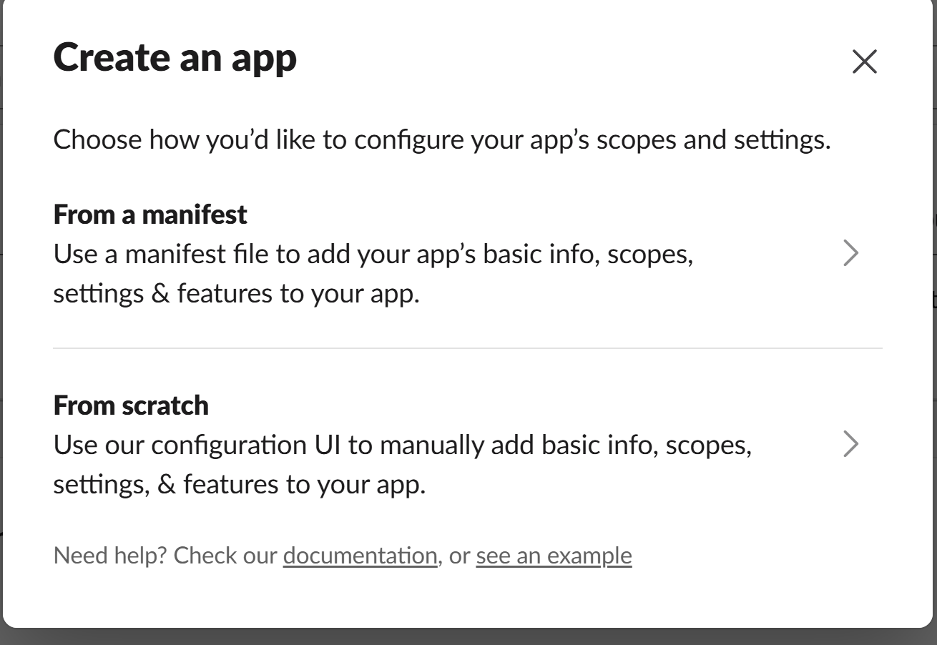
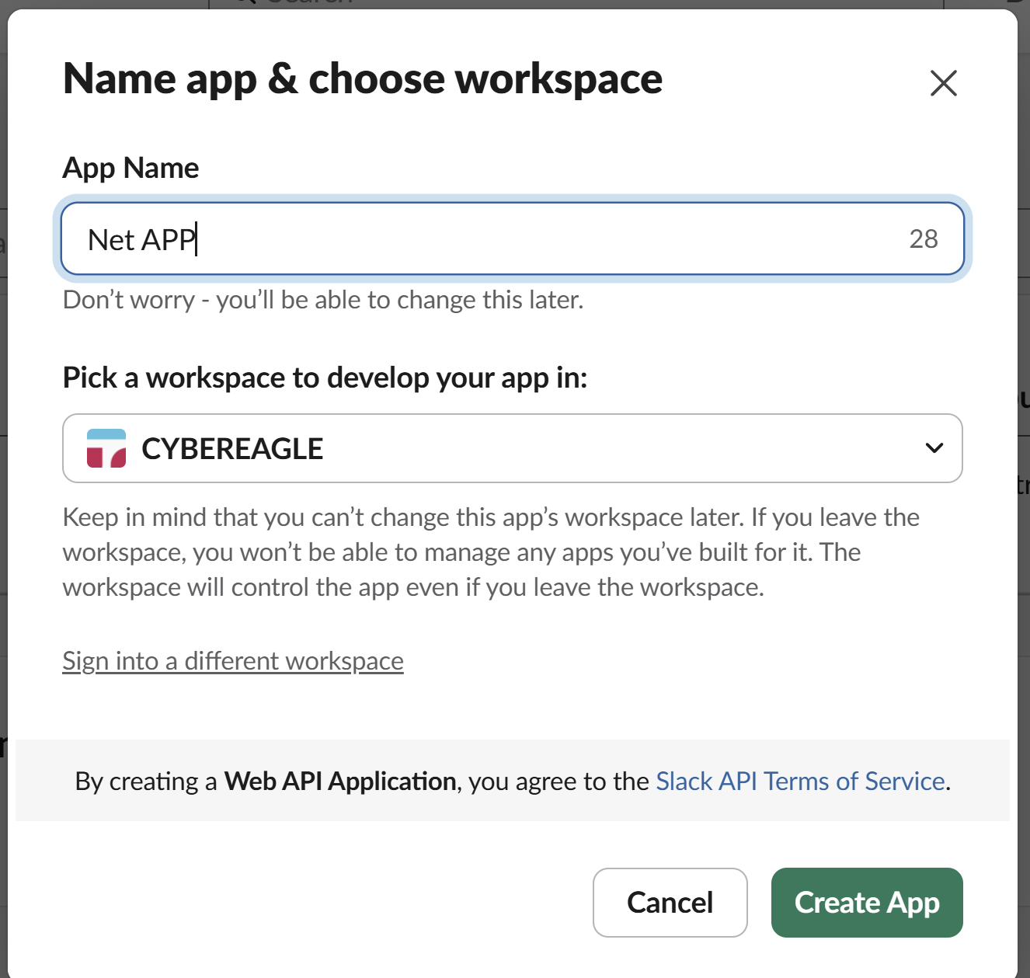
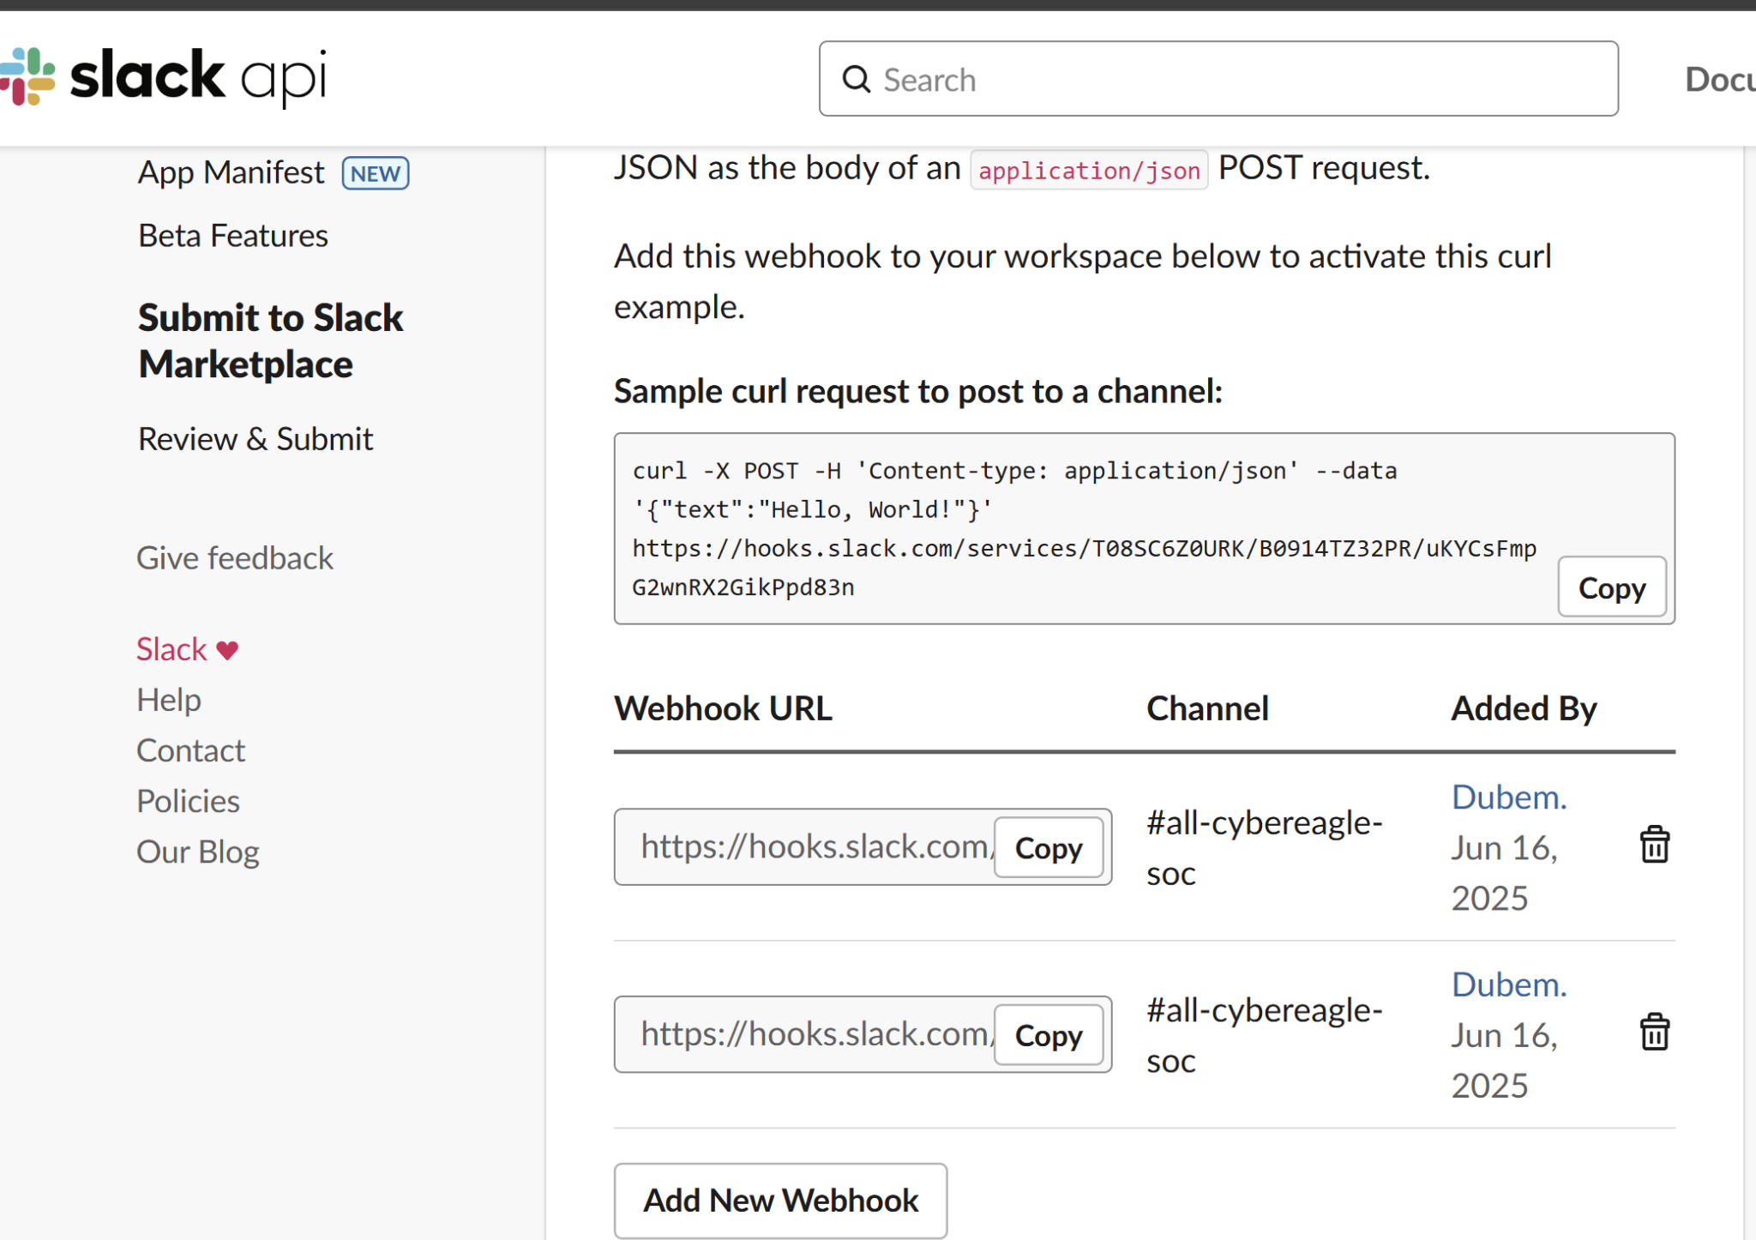
CONTINUE ACTIVE STEP
SLACK APP SET UP
I login to https://api.slack.com/app
I click create a new app {from scratch}
I selected a slack channels {cyber eagle}
I was taken to app {besic information},
I selected {incoming webhook} on the side bar.
I copy webhook url of {all cyber eagle}.

Slide 10
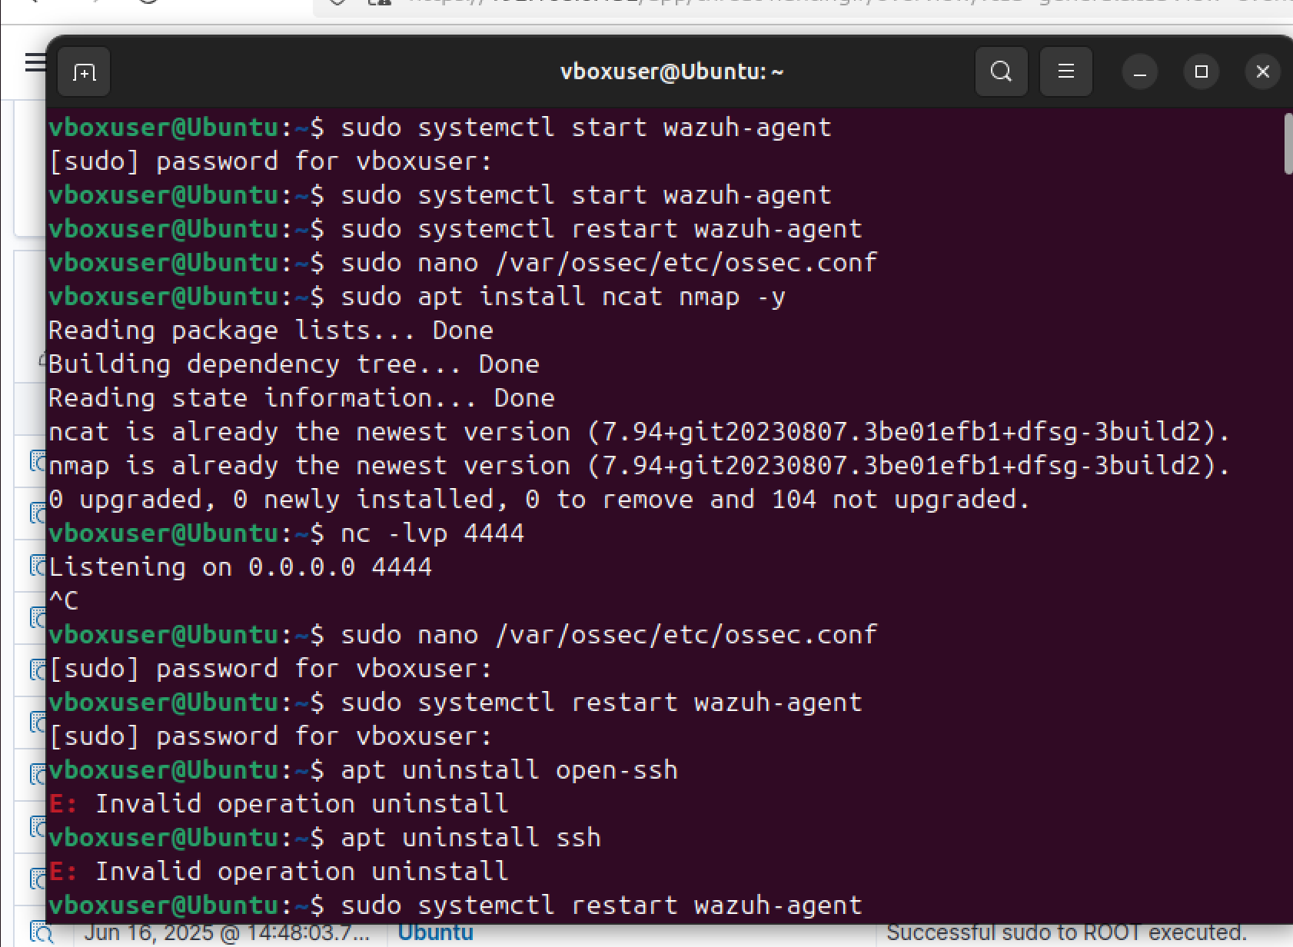
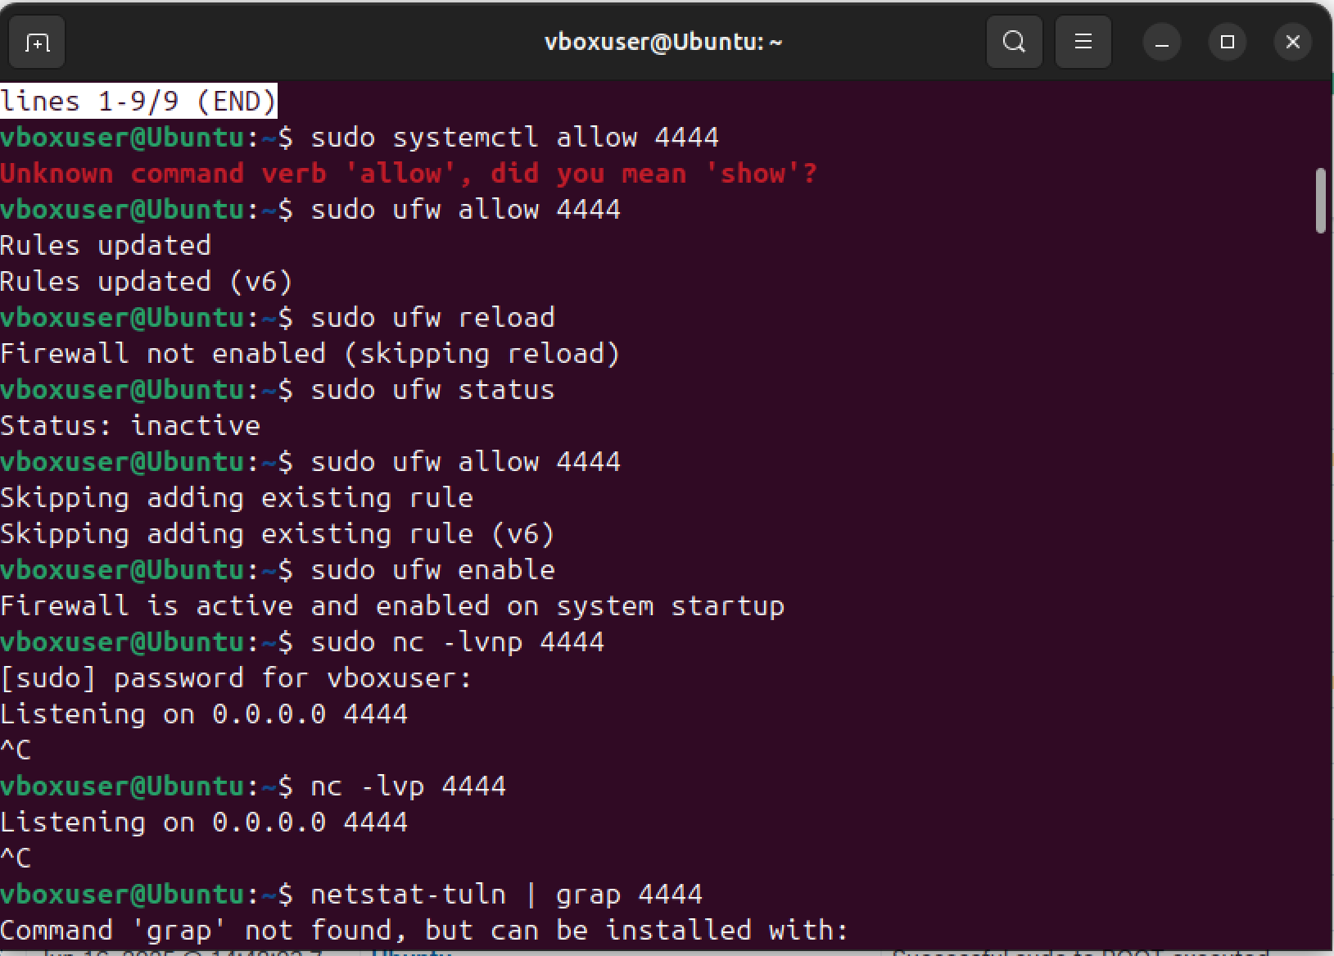
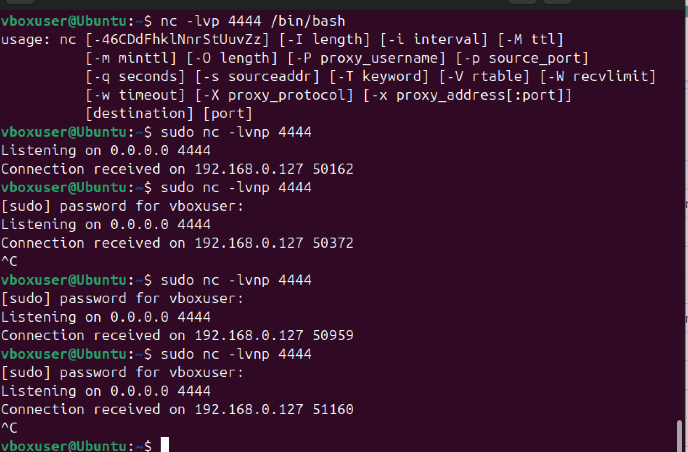
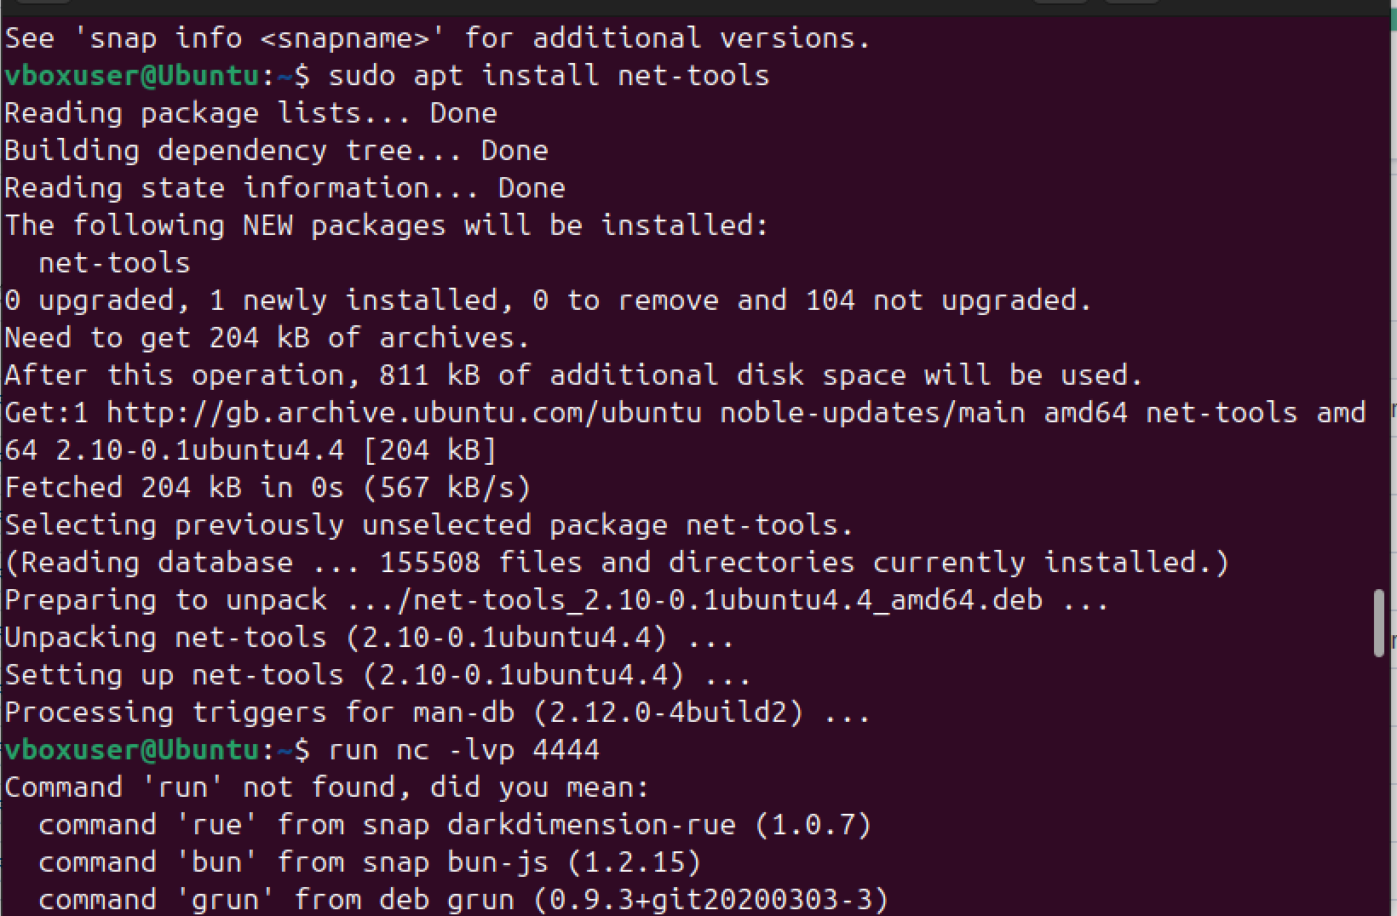
CONTINUE ACTIVE STEP
UBUNTU SET UP
I open ubuntu web browser to confirm my agent deployment
I run the ubuntu terminal
Restart my wazuh agent by {sudo systemctl restart wazuh agent}
Install netcat { sudo apt install ncat nmap -y},
{sudo apt install netcat-traditional} , {sudo ufw enable}, {sudo apt status ufw}
I open up listening port in ubuntu by running { sudo nc -lvnp /bin/bash/}

Slide 11
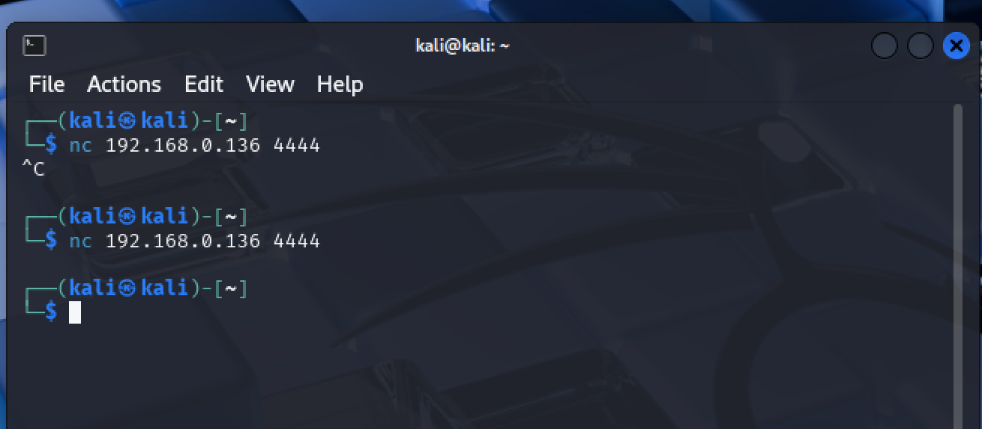
CONTINUE ACTIVE STEP
KALI LINUX SETUP
I open my kali linux
I signup
I goto terminal
Run this command {nc ‘my ubuntu ip address’ 4444} to connect to the my ubuntu that is actively listening.

Slide 12
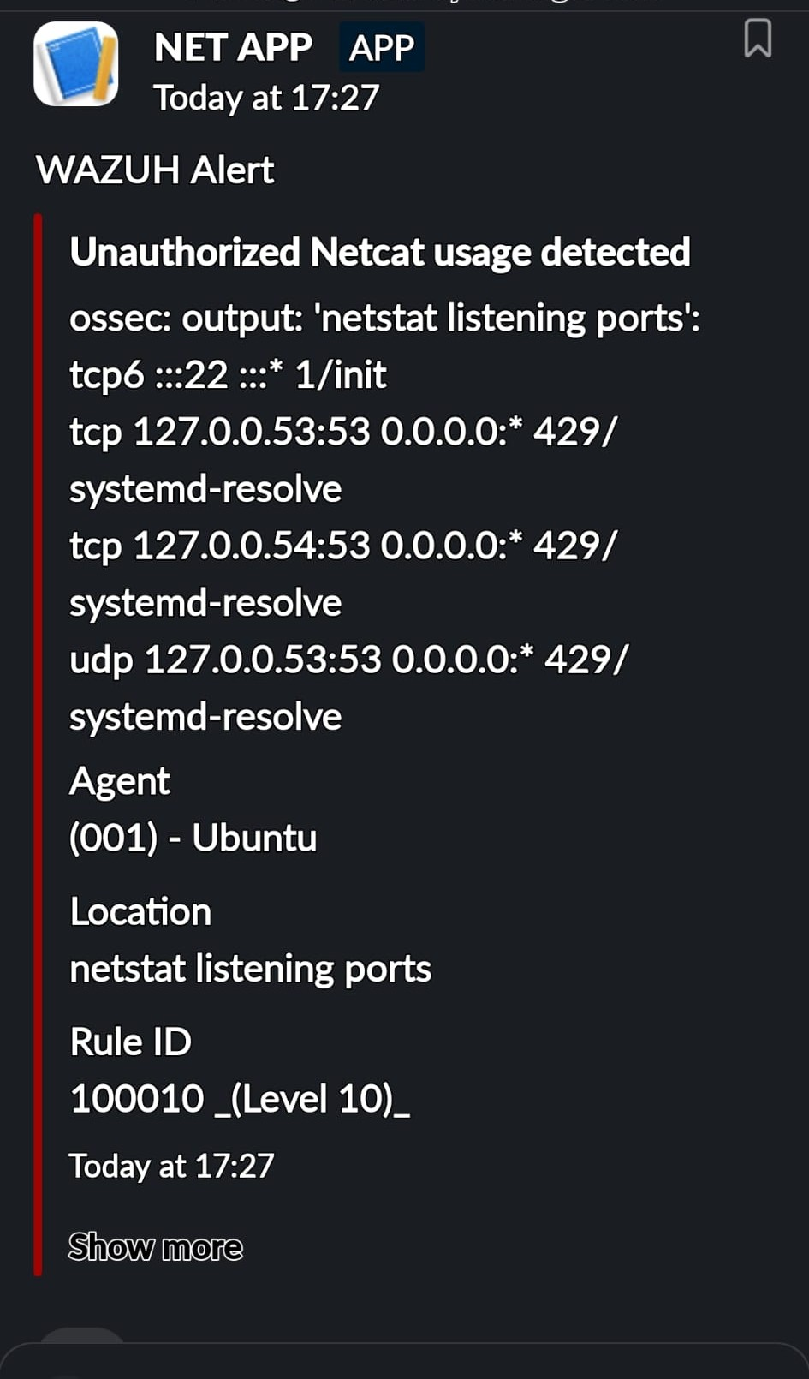
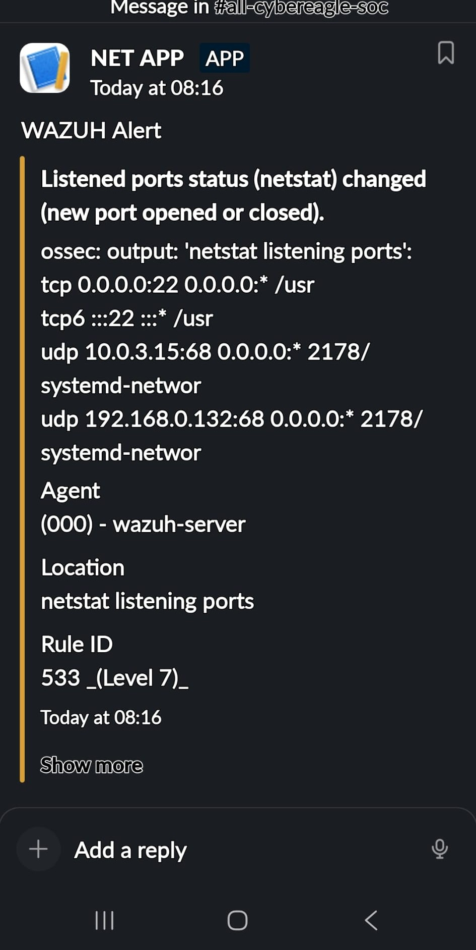
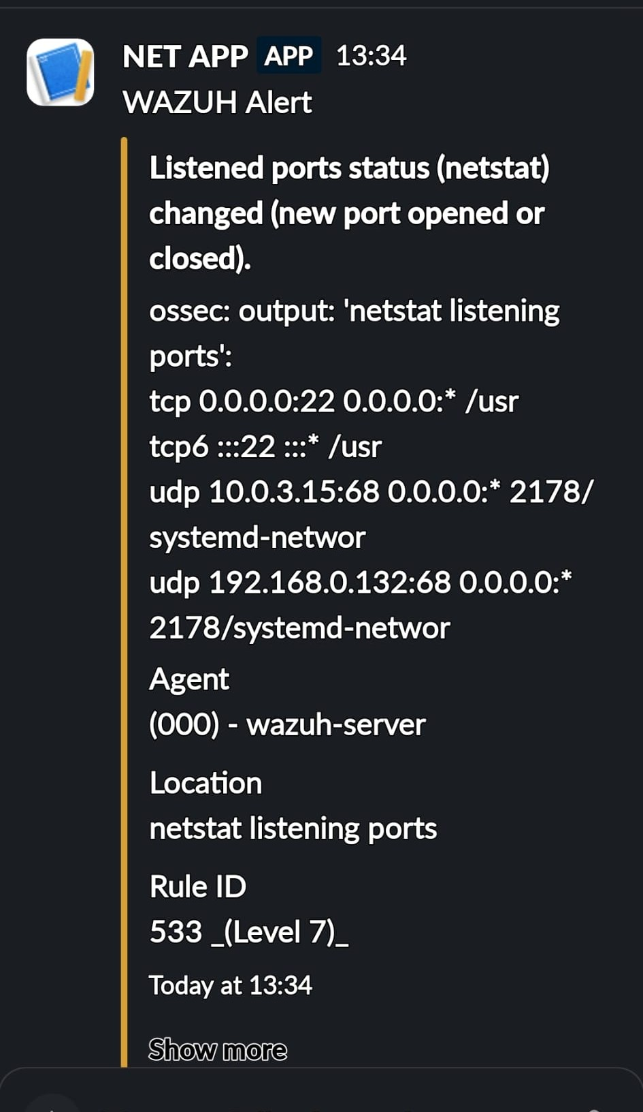
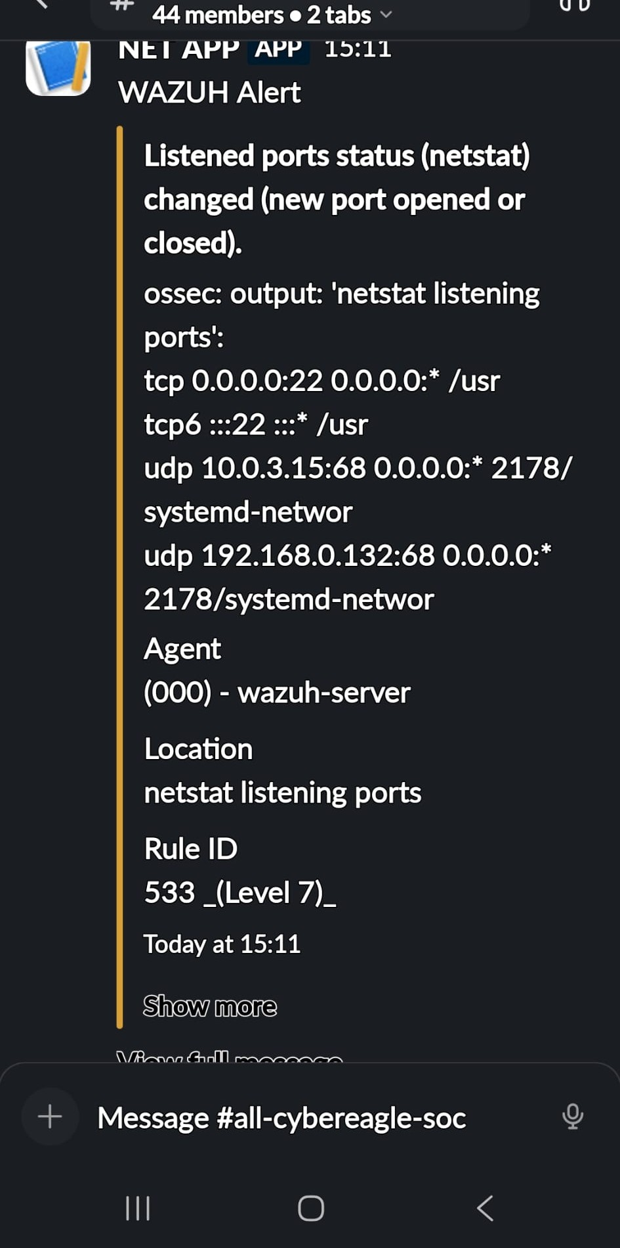
EXPECTED RESULT
SOME OF THE SLACK MESSAGE RECEIVE.

Slide 13
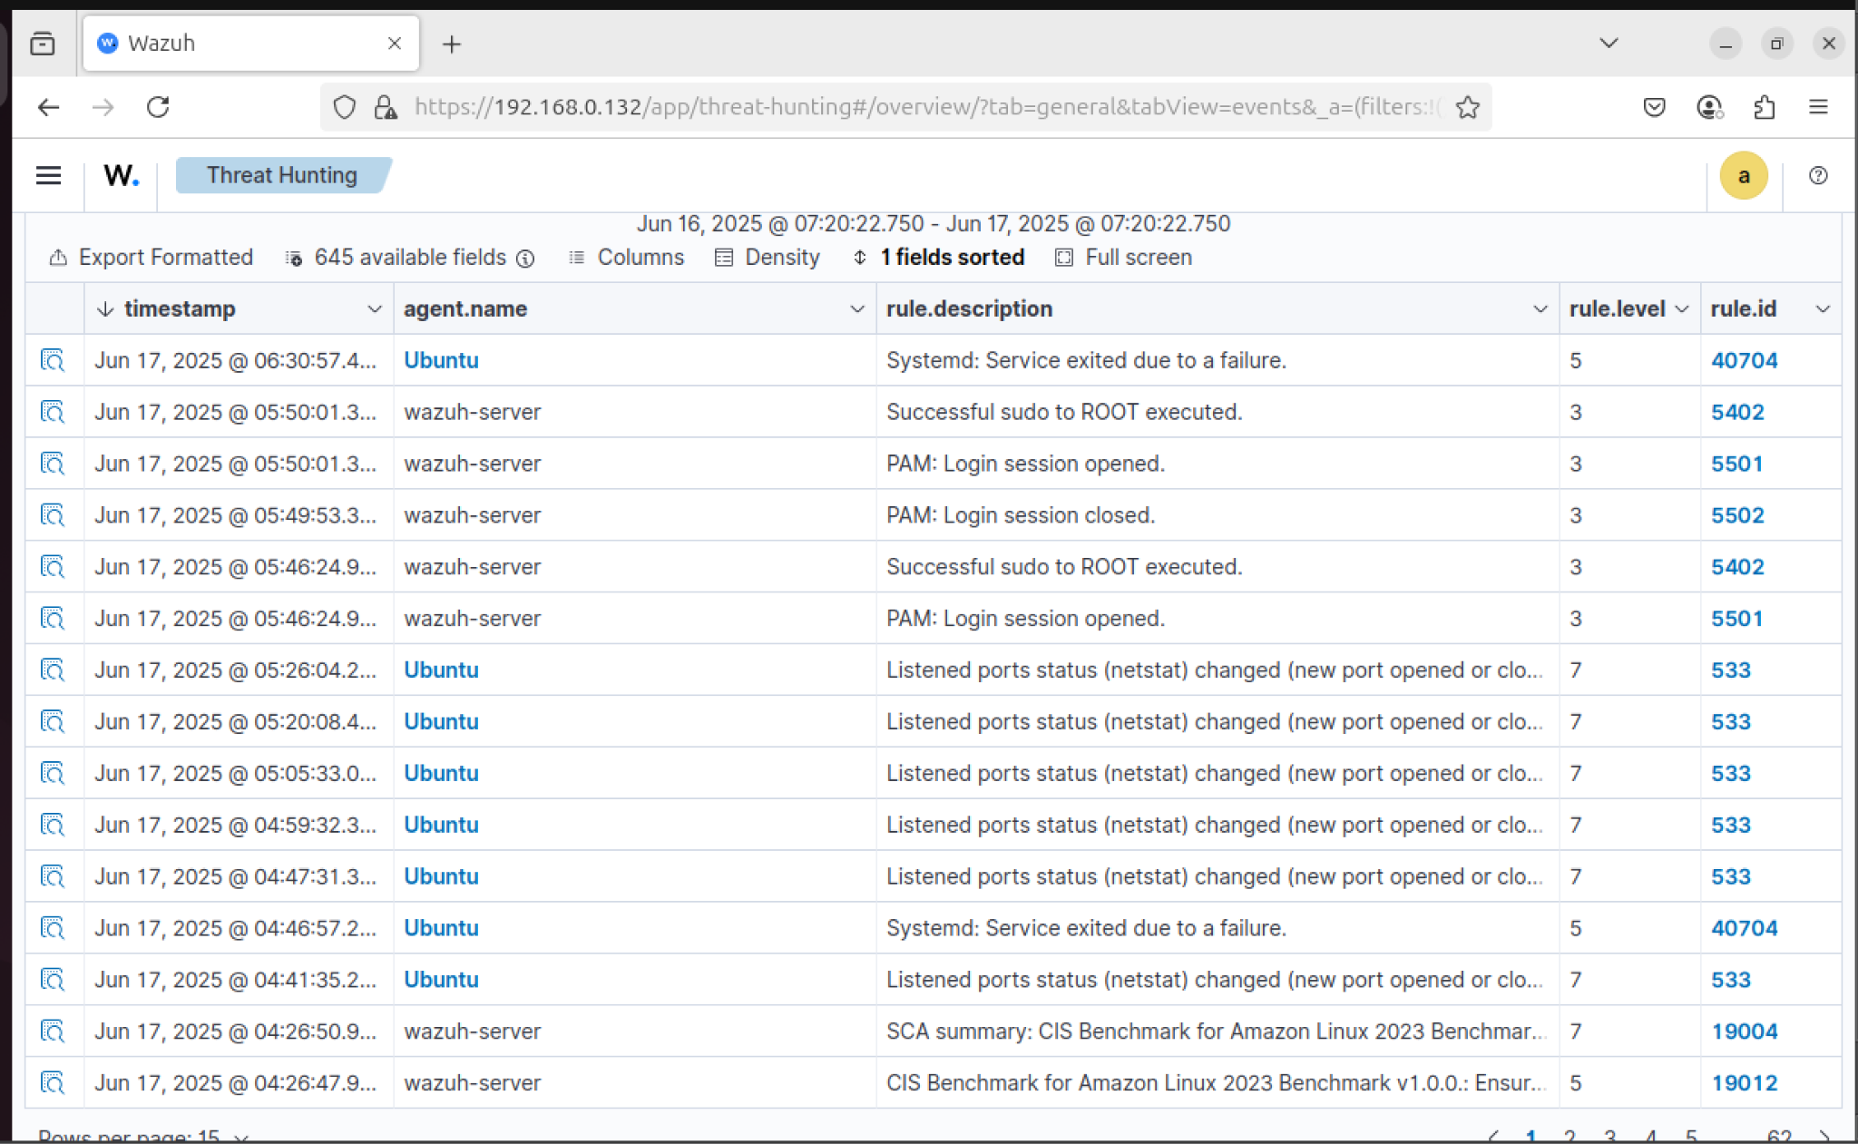
EXPECTED RESULT
MY WAZUS THREAT HUNTING EVENT AND DASHBOARD.

Slide 14
Mitigation Strategies
Restrict Netcat: Remove from non-essential systems (apt-get remove netcat).
AppArmor/SELinux: Restrict execution to authorized users.
Network Monitoring: Add netstat monitoring in ossec.conf.
User Training: Promote secure alternatives (e.g., tcpdump).
Incident Response: Develop playbook for Netcat alerts.

Slide 15
Conclusion
Enhanced detection and response capabilities for 10ALYTICS-DC.
Reduced risk of unauthorized access and data breaches.
Blueprint for future security enhancements.
Next Steps: Expand monitoring to other tools, integrate with SIEM.

